Slide 1
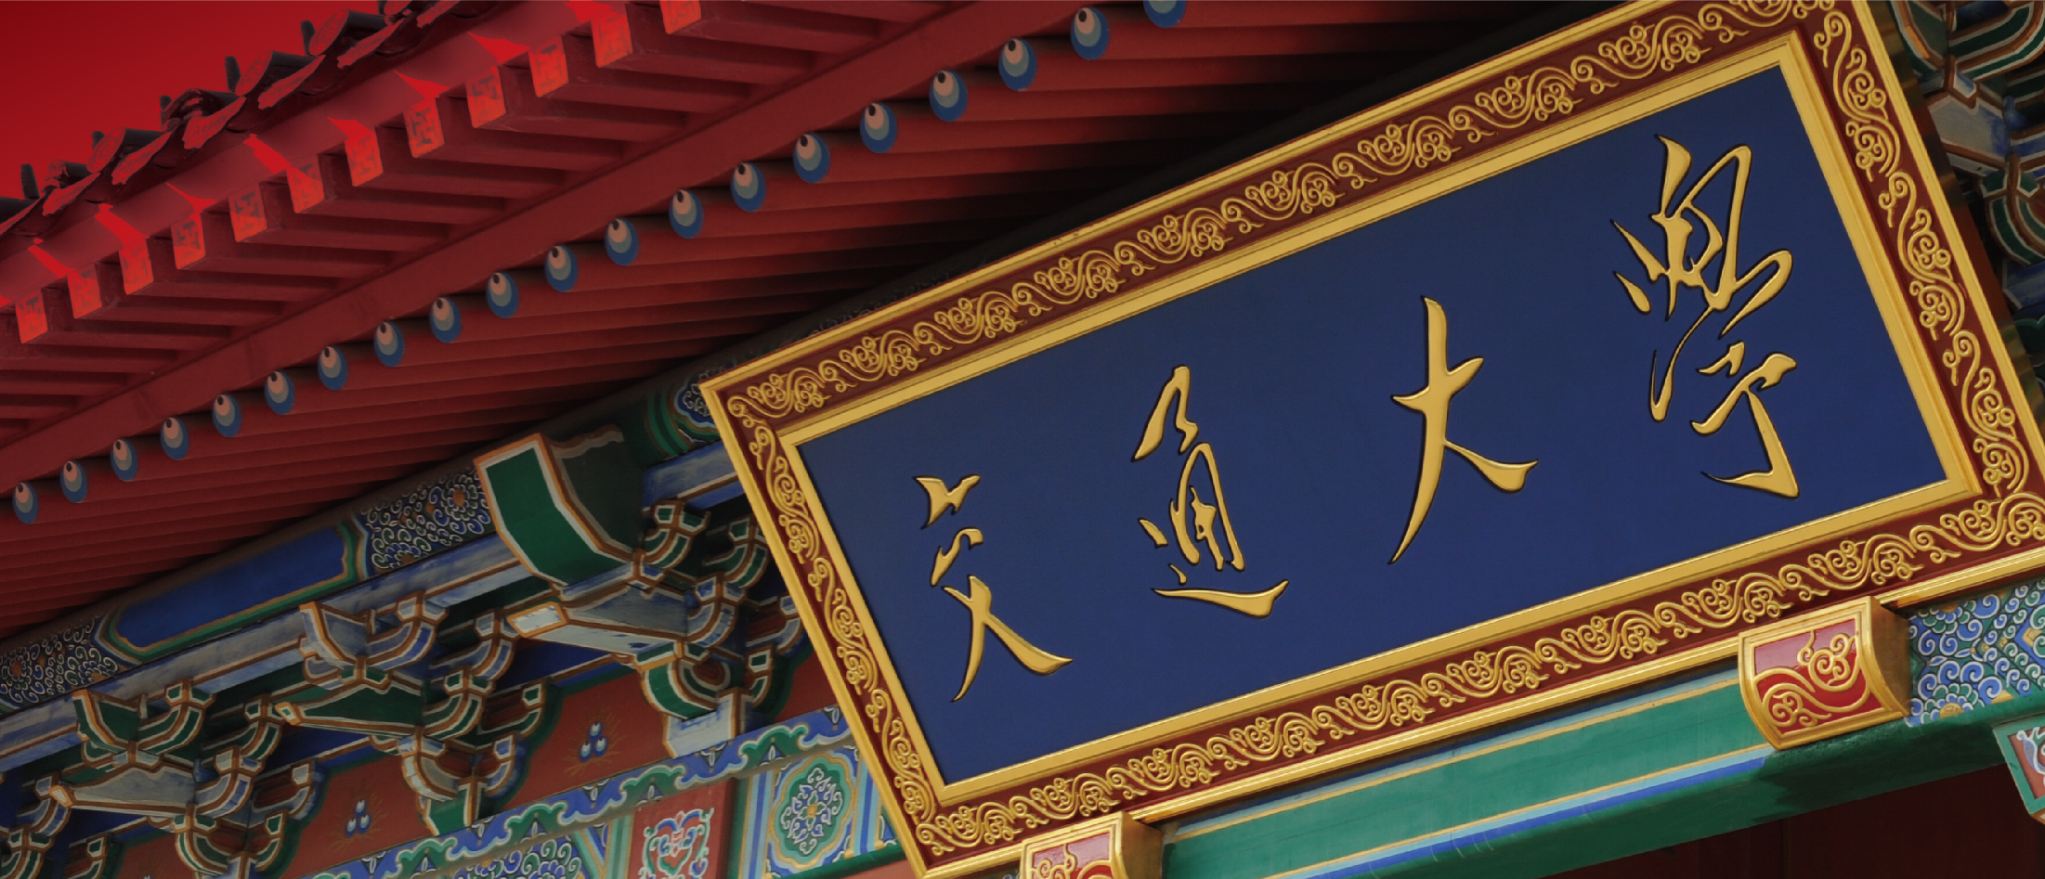
CS420 Machine Learning Project
Ruiheng Chang, 515021910459
Weichao Mao, 515021910559

Slide 2
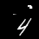
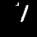
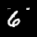
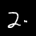
Overview
Target problem:
A classification problem on a modified MNIST dataset.
60000 training samples, 10000 testing samples, 45×45.
Sample examples.

Slide 3
Results
Traditional methods:
KNN: 98.40% (without preprocessing: 88.12%).
SVM: 98.75% (without preprocessing: 93.22%).
Ensemble: 98.40%.

Slide 4
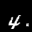
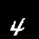

Preprocessing
Invert the artificial disturbance.
1. Original image
2. Denoised
3. Cropped
4. Centered
Preprocessing pipeline.

Slide 5
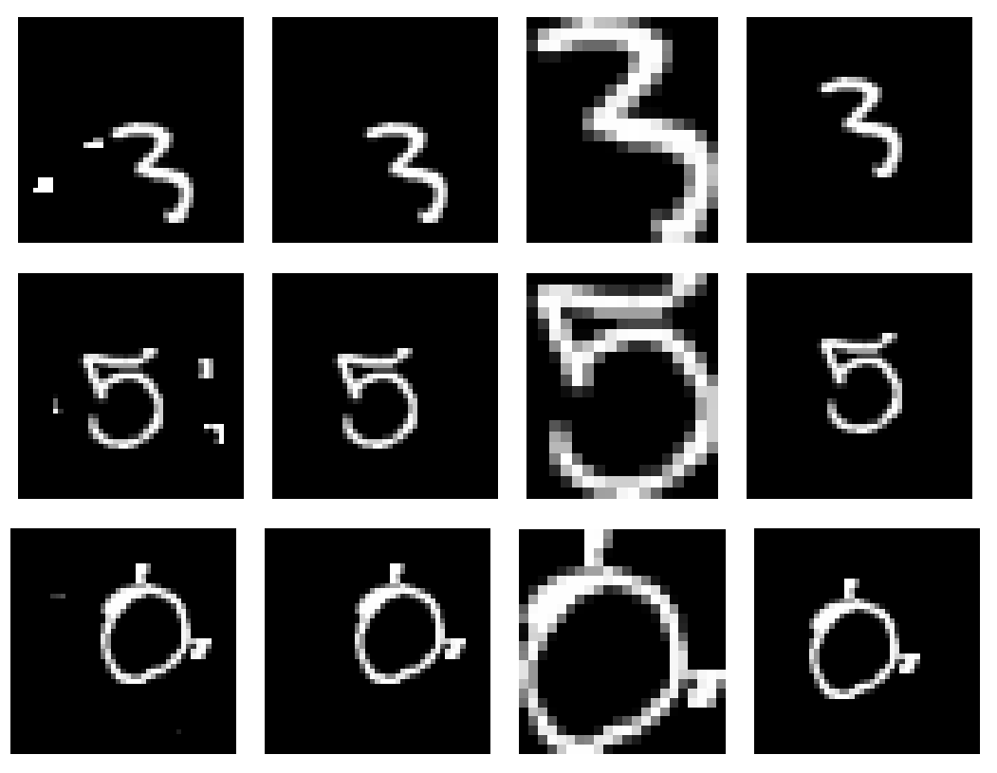
More Examples
Hough transform?
More examples of preprocessing, including a failure case.

Slide 6
KNN & SVM
KNN:
PCA ratio = 1.0, k = 1.
Accuracy: 98.40% (without preprocessing: 88.12%).
SVM
rbf kernel, PCA ratio = 0.85, C =5, gamma = 5e-7.
Accuracy: 98.75% (without preprocessing: 93.22%).

Slide 7

Ensemble Method
A soft voting classifier of KNN and SVM:
Accuracy: 98.40%. (Worse than SVM alone.)
Illustration of a voting classifier. Image source: https://www.toptal.com/machine-learning/ensemble-methods-machine-learning

Slide 8
Analysis
Only two voters (typically more than 100).
Variance is lowered by independence.
Details in the report.

Slide 9
CNN
Simple CNN
VGG Net
Resnet

Slide 10
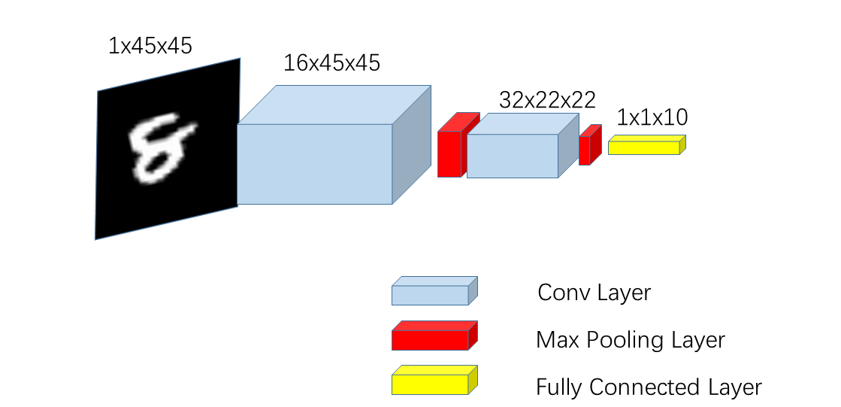
Simple CNN
Very Simple architecture (2 conv layer)
Accuracy: 97.16%

Slide 11
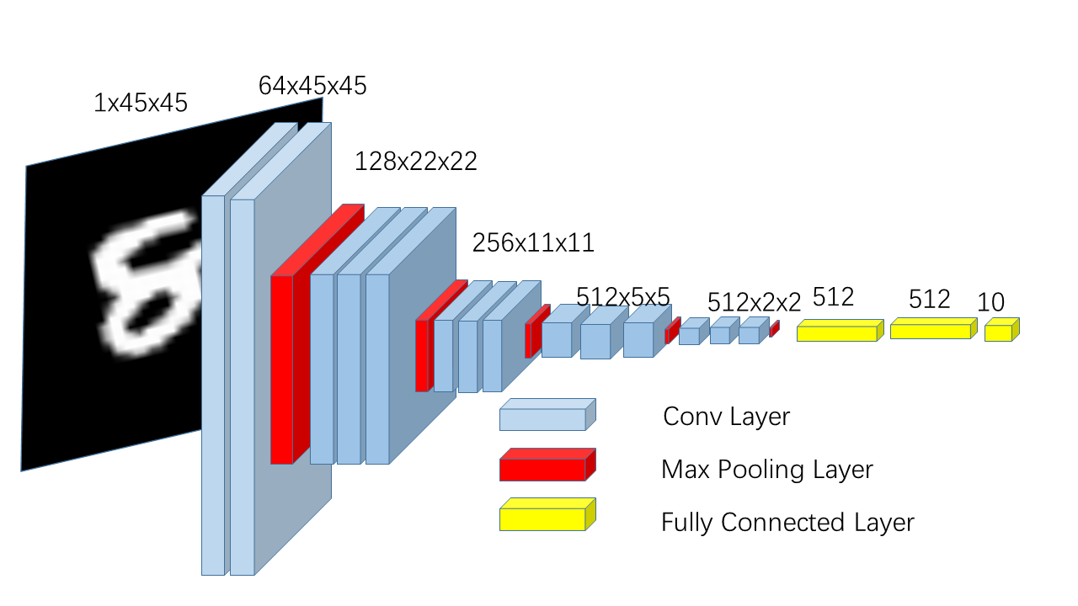
VGG Net
Very classical network…
Proposed by Visual Geometry Group, University of Oxford
Main idea: GO DEEPER !!!

Slide 12
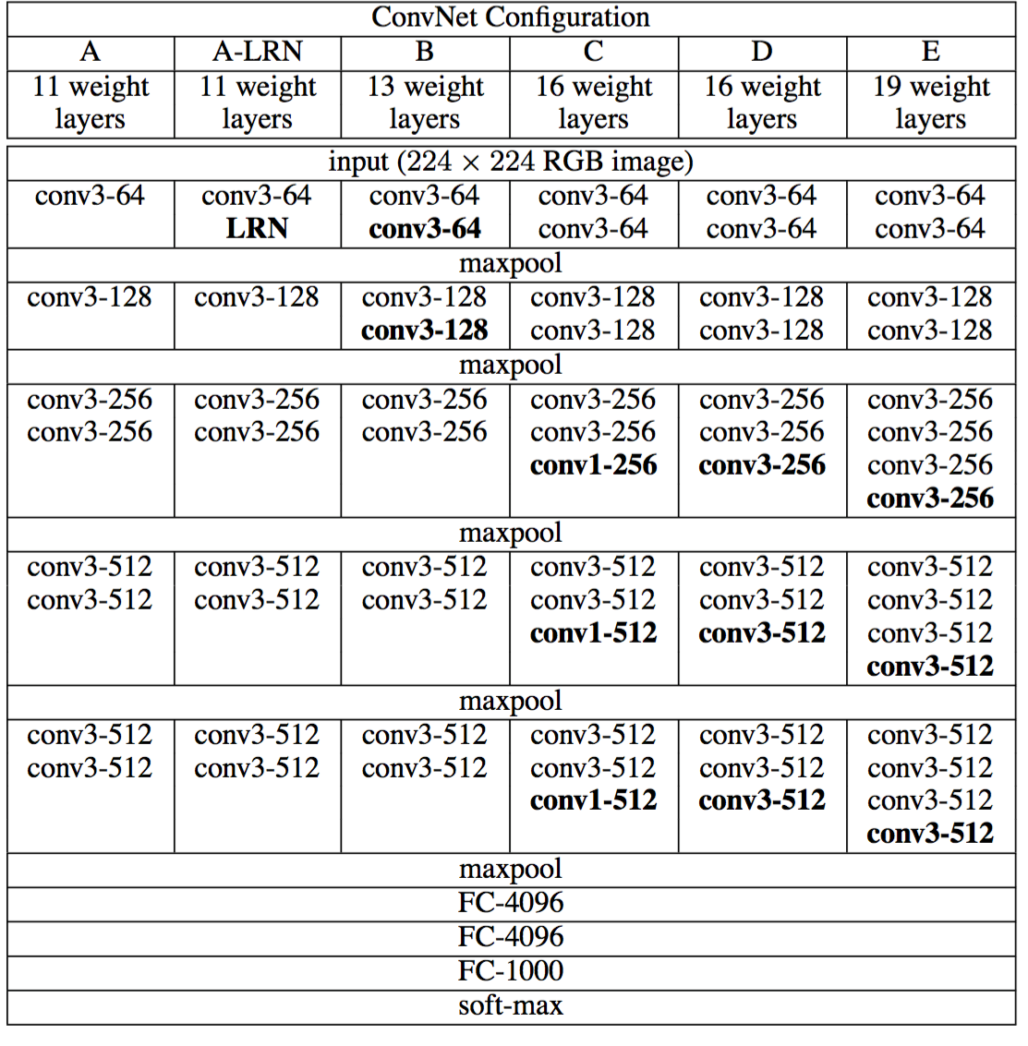
VGG Net
Accuracy:
VGG11: 99.50%
VGG16: 99.71%

Slide 13
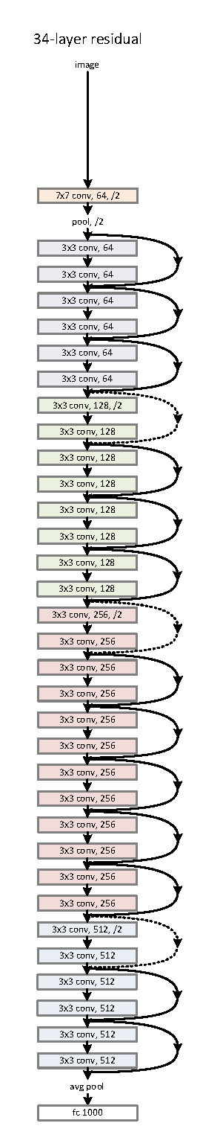
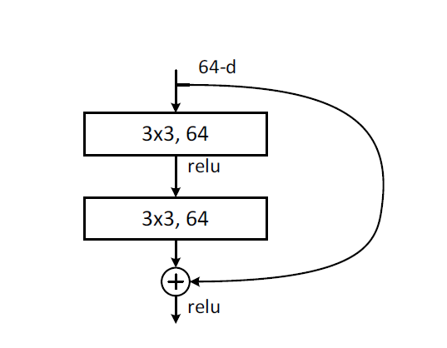
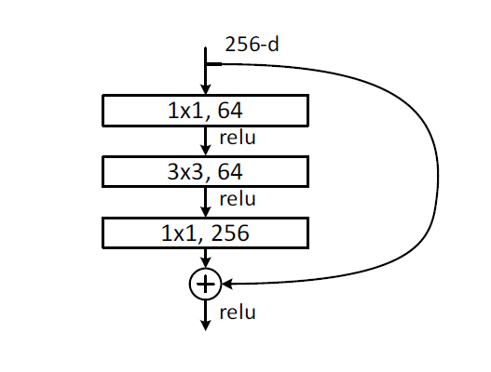
ResNet
Very popular
State-of-the-art backbone of many networks
Very Deep

Slide 14
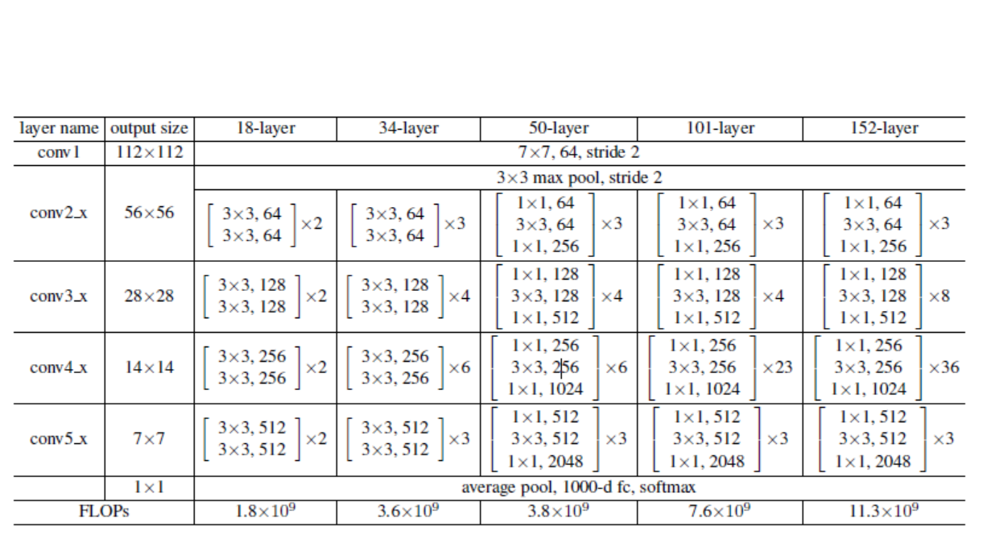
ResNet

Slide 15
ResNet
Accuracy:
Res101: 99.73% Res50: 99.65%
Res34: 99.67% Res18: 99.59%
Res101 achieves best accuracy
We combine Res101 with image processing and get 99.8% accuracy

Slide 16
Capsule
The limitation of CNN:
CNN lose the relationship of feature of entity
CNN cannot handle the rotation and transformation of image

Slide 17
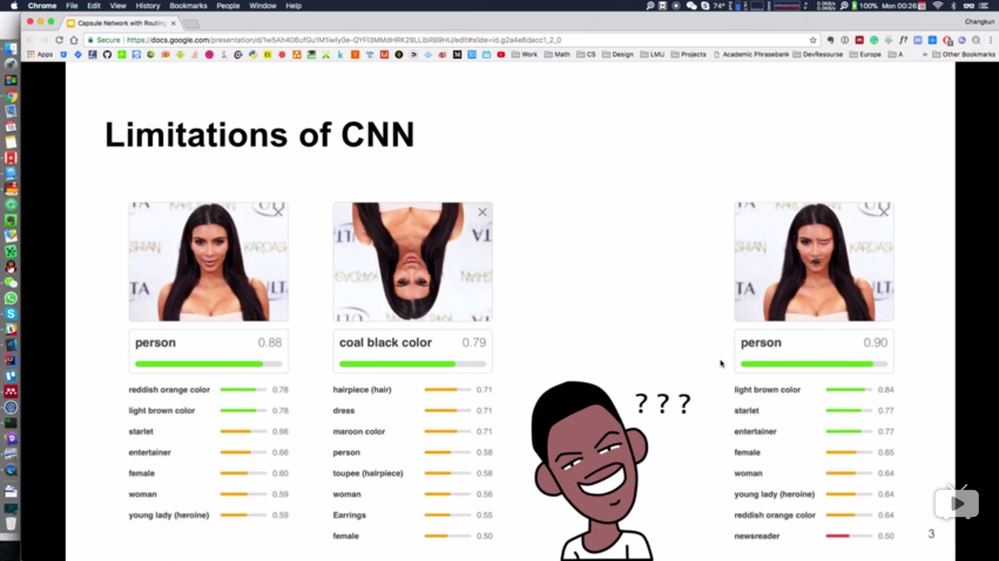
Capsule

Slide 18
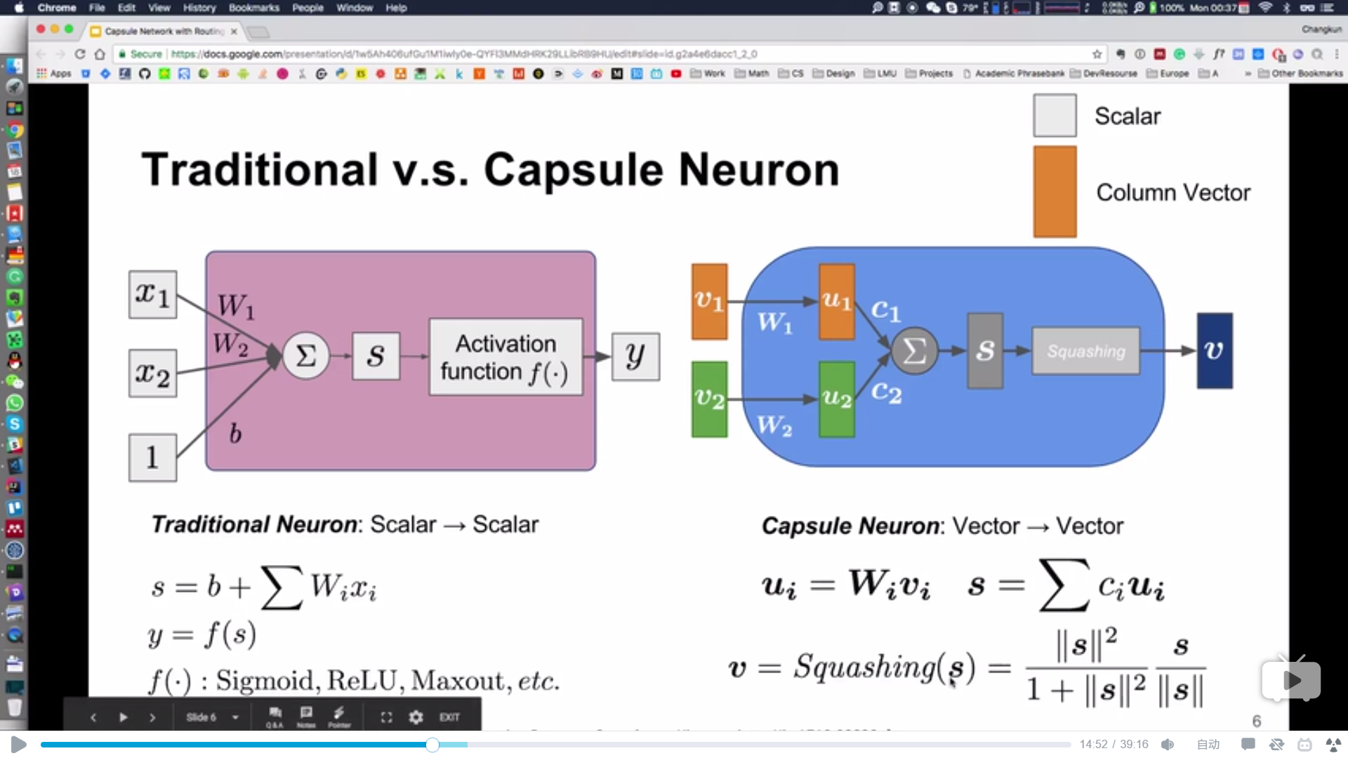
Capsule

Slide 19
Capsule
Feature of Capsule :
Capsule output vector
Dynamic Routing, replace max-pooling with routing-by-agreement
Capsule can better capture the relationship of features or parts of entity
Accuracy: 99.78% without image processing

Slide 20
Data Augmentation
Crop
Rotate
Resize
Conditional GAN
……

Slide 21
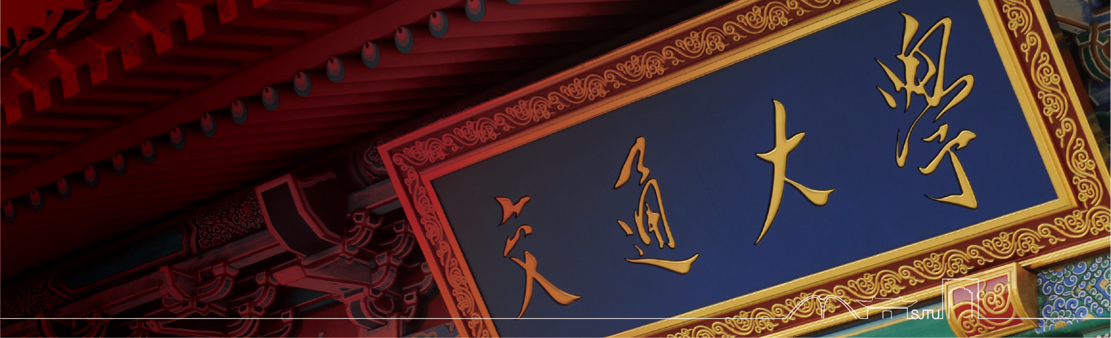

THANKS

